Slide 1

Team name — Nexus for AMD
Team leader name — Likhith Kanigolla
Problem Statement — AI for Smart Cities
Proposed Solution — Smart Campus Crowd Management using Digital Twin & IoT Sensors
Team Details

Slide 2

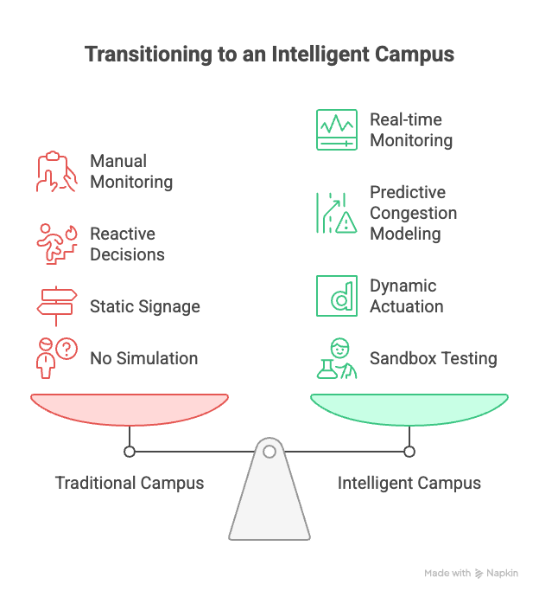
Brief about the idea
CrowdTwin is a real-time Digital Twin platform for university campus crowd management
IoT sensors (cameras, occupancy sensors, road monitors) are deployed across the campus to capture live crowd data
A 3D interactive map renders the campus with semantic building classification and real-time agent movement
Three operational modes: Visualize (monitor), Actuate (control), Simulate (predict)
AI-powered decision engine (Gemini/GPT) provides smart recommendations for crowd management
Prevents stampedes, optimizes event logistics, and enables data-driven campus planning
CrowdTwin observes, predicts, decides, and intervenes in real-time.”
Projected Peak Conditions (Medium-sized campus):
• 1,000–3,000 people moving simultaneously
• 8–15 high-density hotspots
• 2–5 min delay in manual response

Slide 3
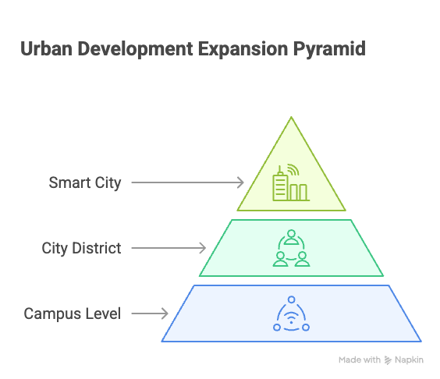
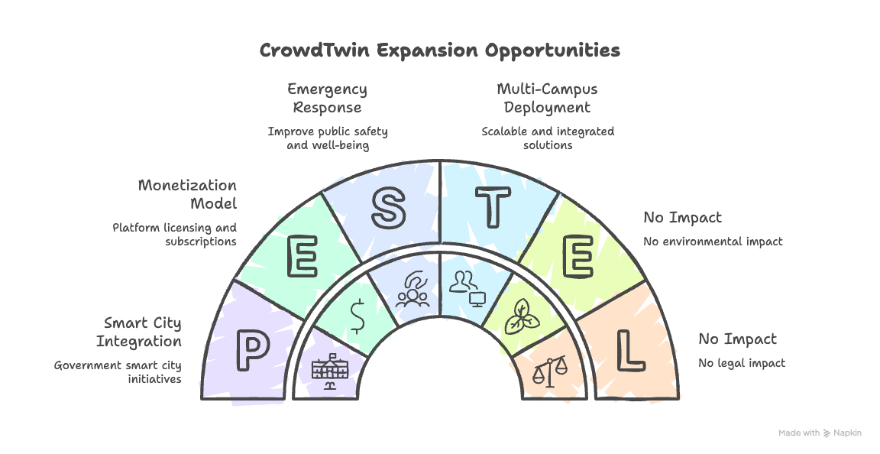
Opportunities

Slide 4
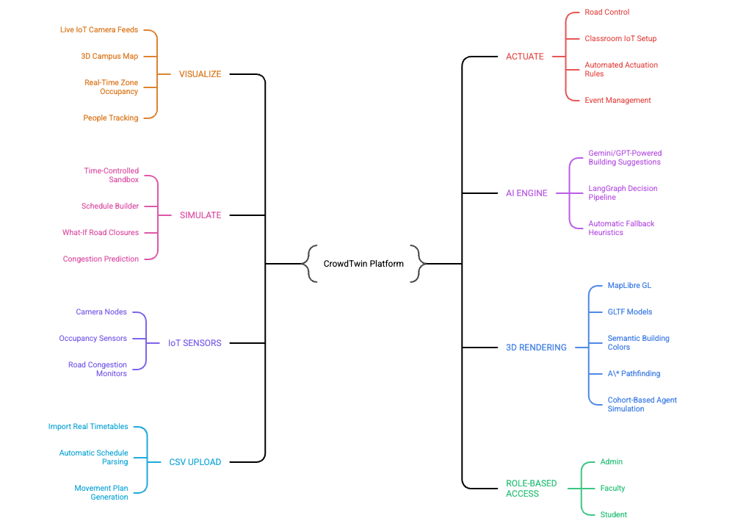
List of features offered by the solution
• VISUALIZE: Live IoT camera feeds, 3D campus map, real-time zone occupancy, people tracking
• ACTUATE: Road control (Open/Soft Close/Hard Close), classroom IoT setup, automated actuation rules, event management
• SIMULATE: Time-controlled sandbox (1x/5x/15x), schedule builder, what-if road closures, congestion prediction
• AI ENGINE: Gemini/GPT-powered building suggestions, LangGraph decision pipeline, automatic fallback heuristics
• IoT SENSORS: camera nodes at building entrances, occupancy sensors in buildings, road congestion monitors
• 3D RENDERING: MapLibre GL with GLTF models, semantic building colors, A* pathfinding, cohort-based agent simulation
• CSV UPLOAD: Import real timetables, automatic schedule parsing, movement plan generation
• ROLE-BASED ACCESS: Admin (full control), Faculty (classroom setup), Student (limited actuation)

Slide 5
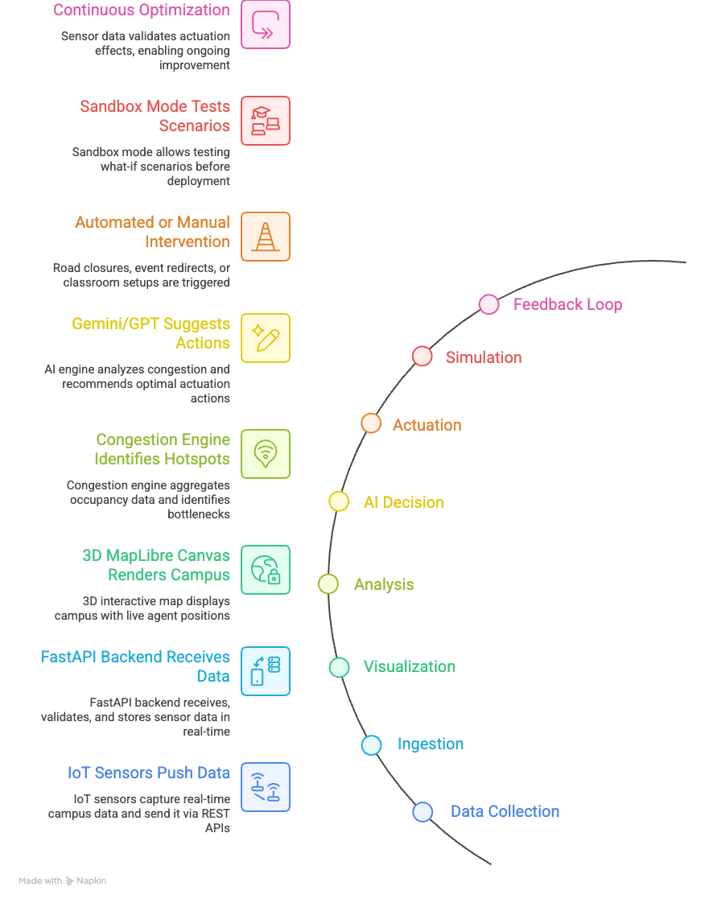
Process flow diagram or Use-case diagram
Process Flow:
IoT → Digital Twin → AI → Actuation
• DATA COLLECTION: IoT sensors (cameras, occupancy, road monitors) push data via REST APIs
• INGESTION: FastAPI backend receives, validates, and stores sensor data in real-time
• VISUALIZATION: 3D MapLibre canvas renders campus with live agent positions from sensor data
• ANALYSIS: Congestion engine aggregates occupancy data, identifies hotspots and bottlenecks
• AI DECISION: Gemini/GPT analyzes congestion patterns and suggests optimal actuation actions
• ACTUATION: Road closures, event redirects, and classroom setup triggered automatically or manually
• SIMULATION: Sandbox mode allows testing what-if scenarios before deploying changes
• FEEDBACK LOOP: Sensor data validates actuation effects, enabling continuous optimization

Slide 6
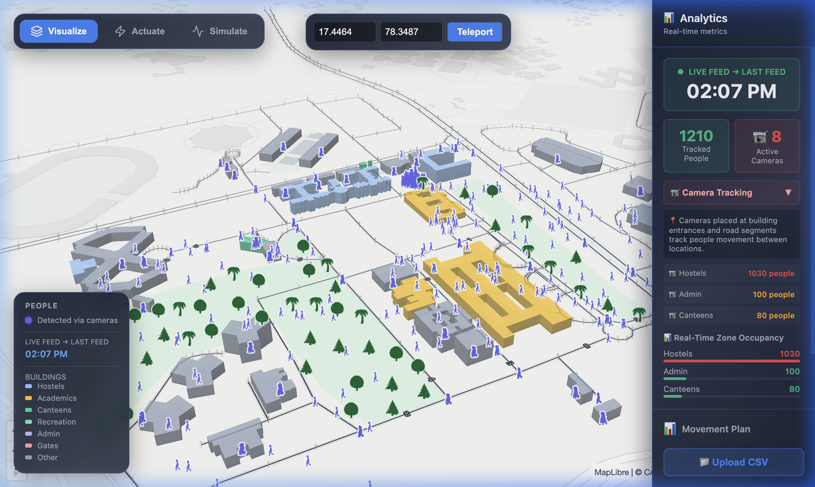
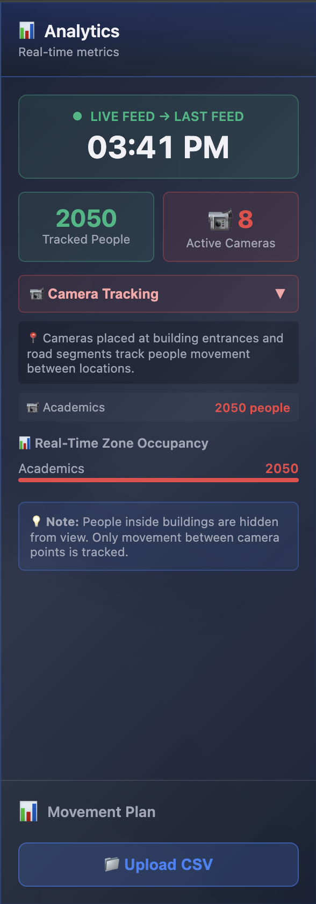
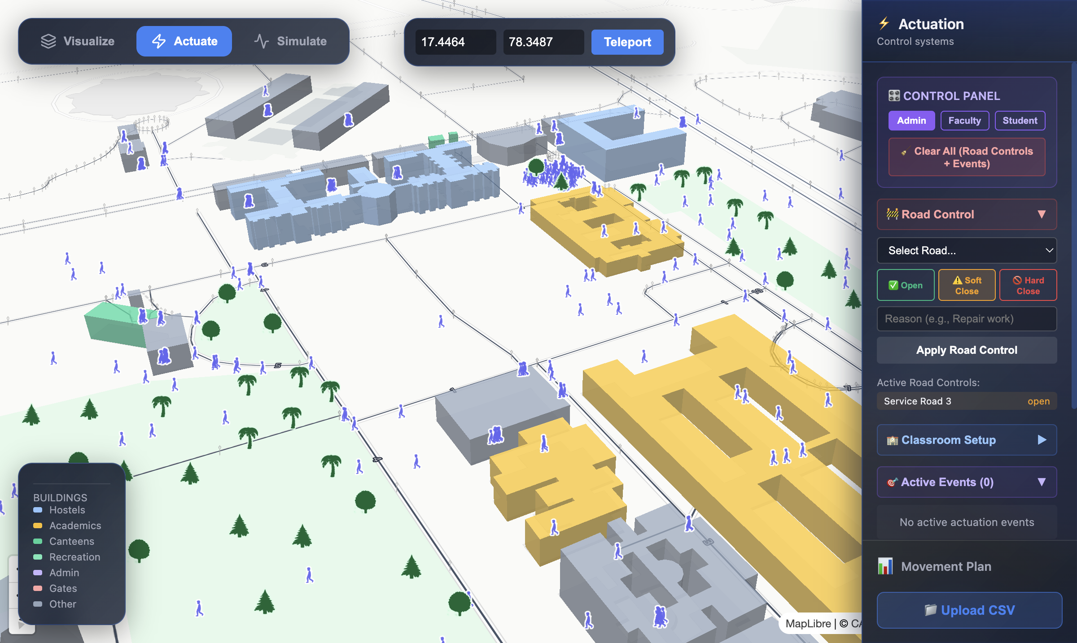
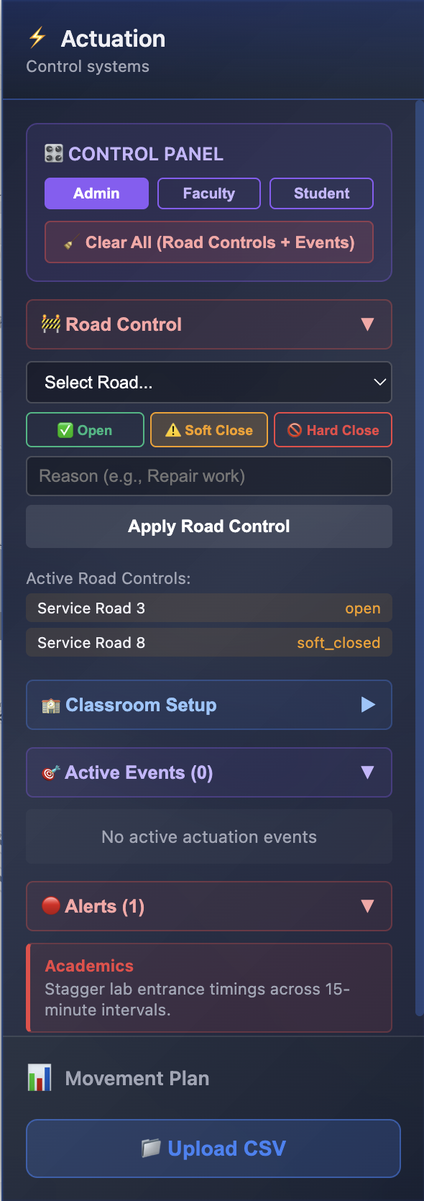
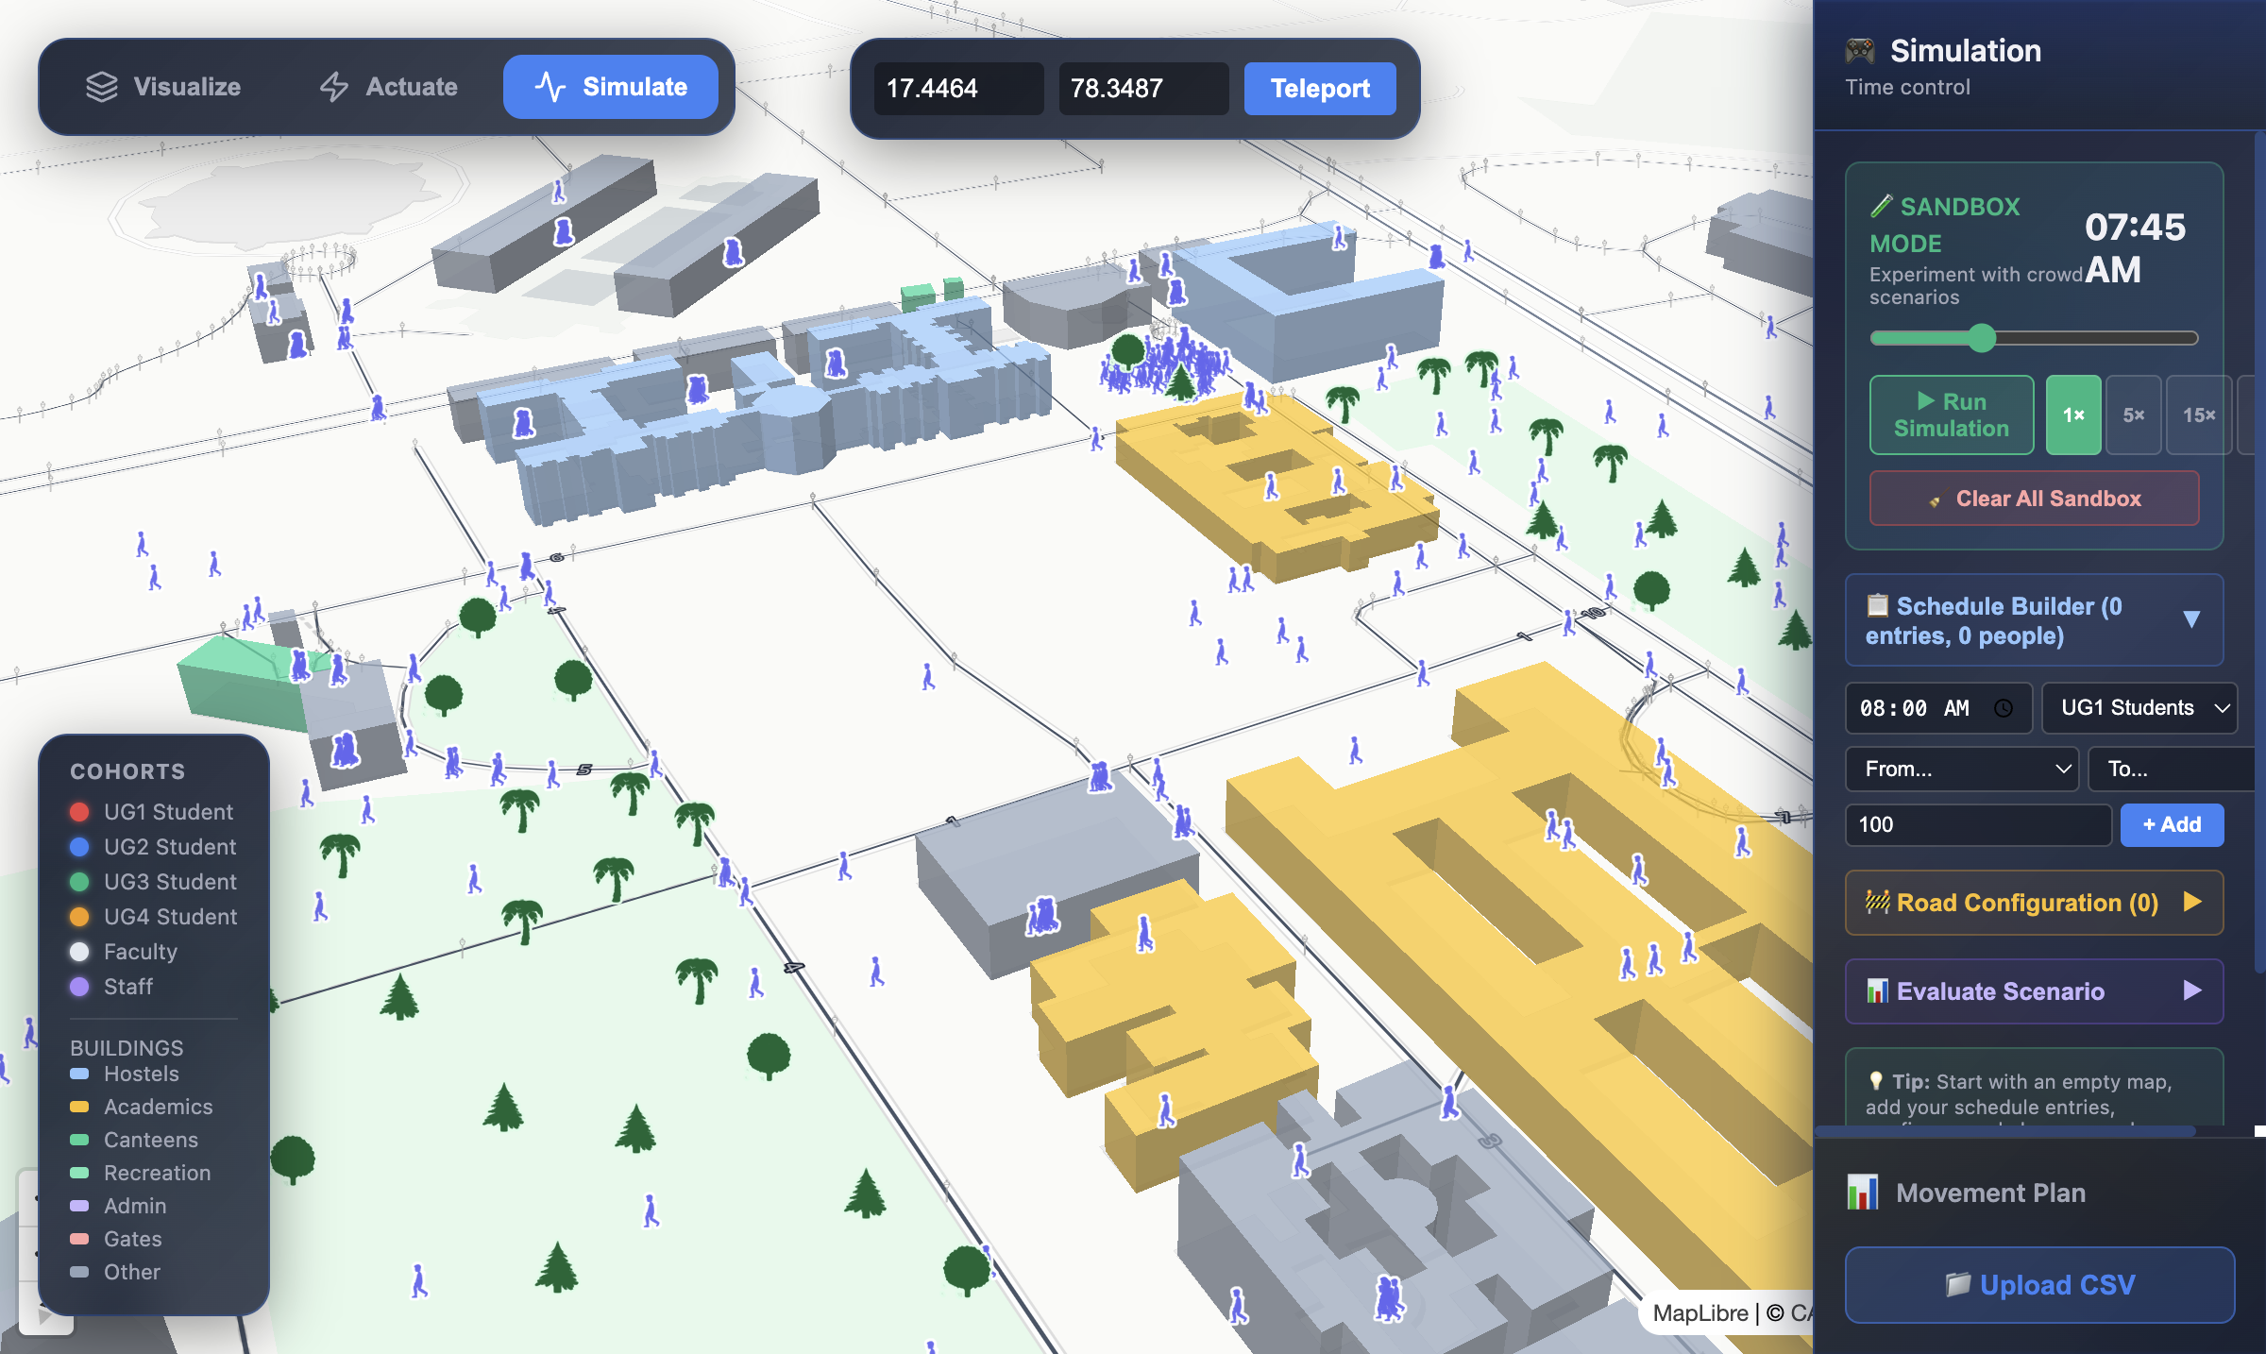
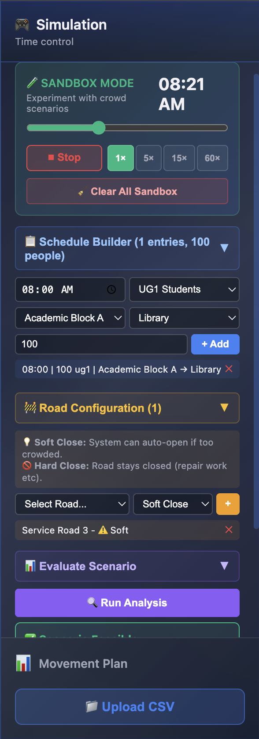
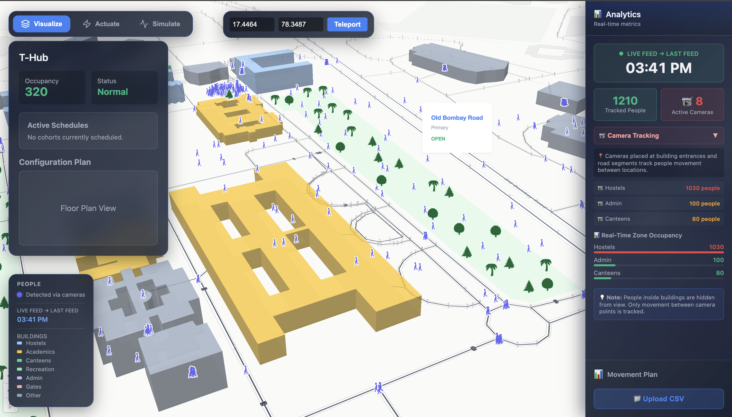
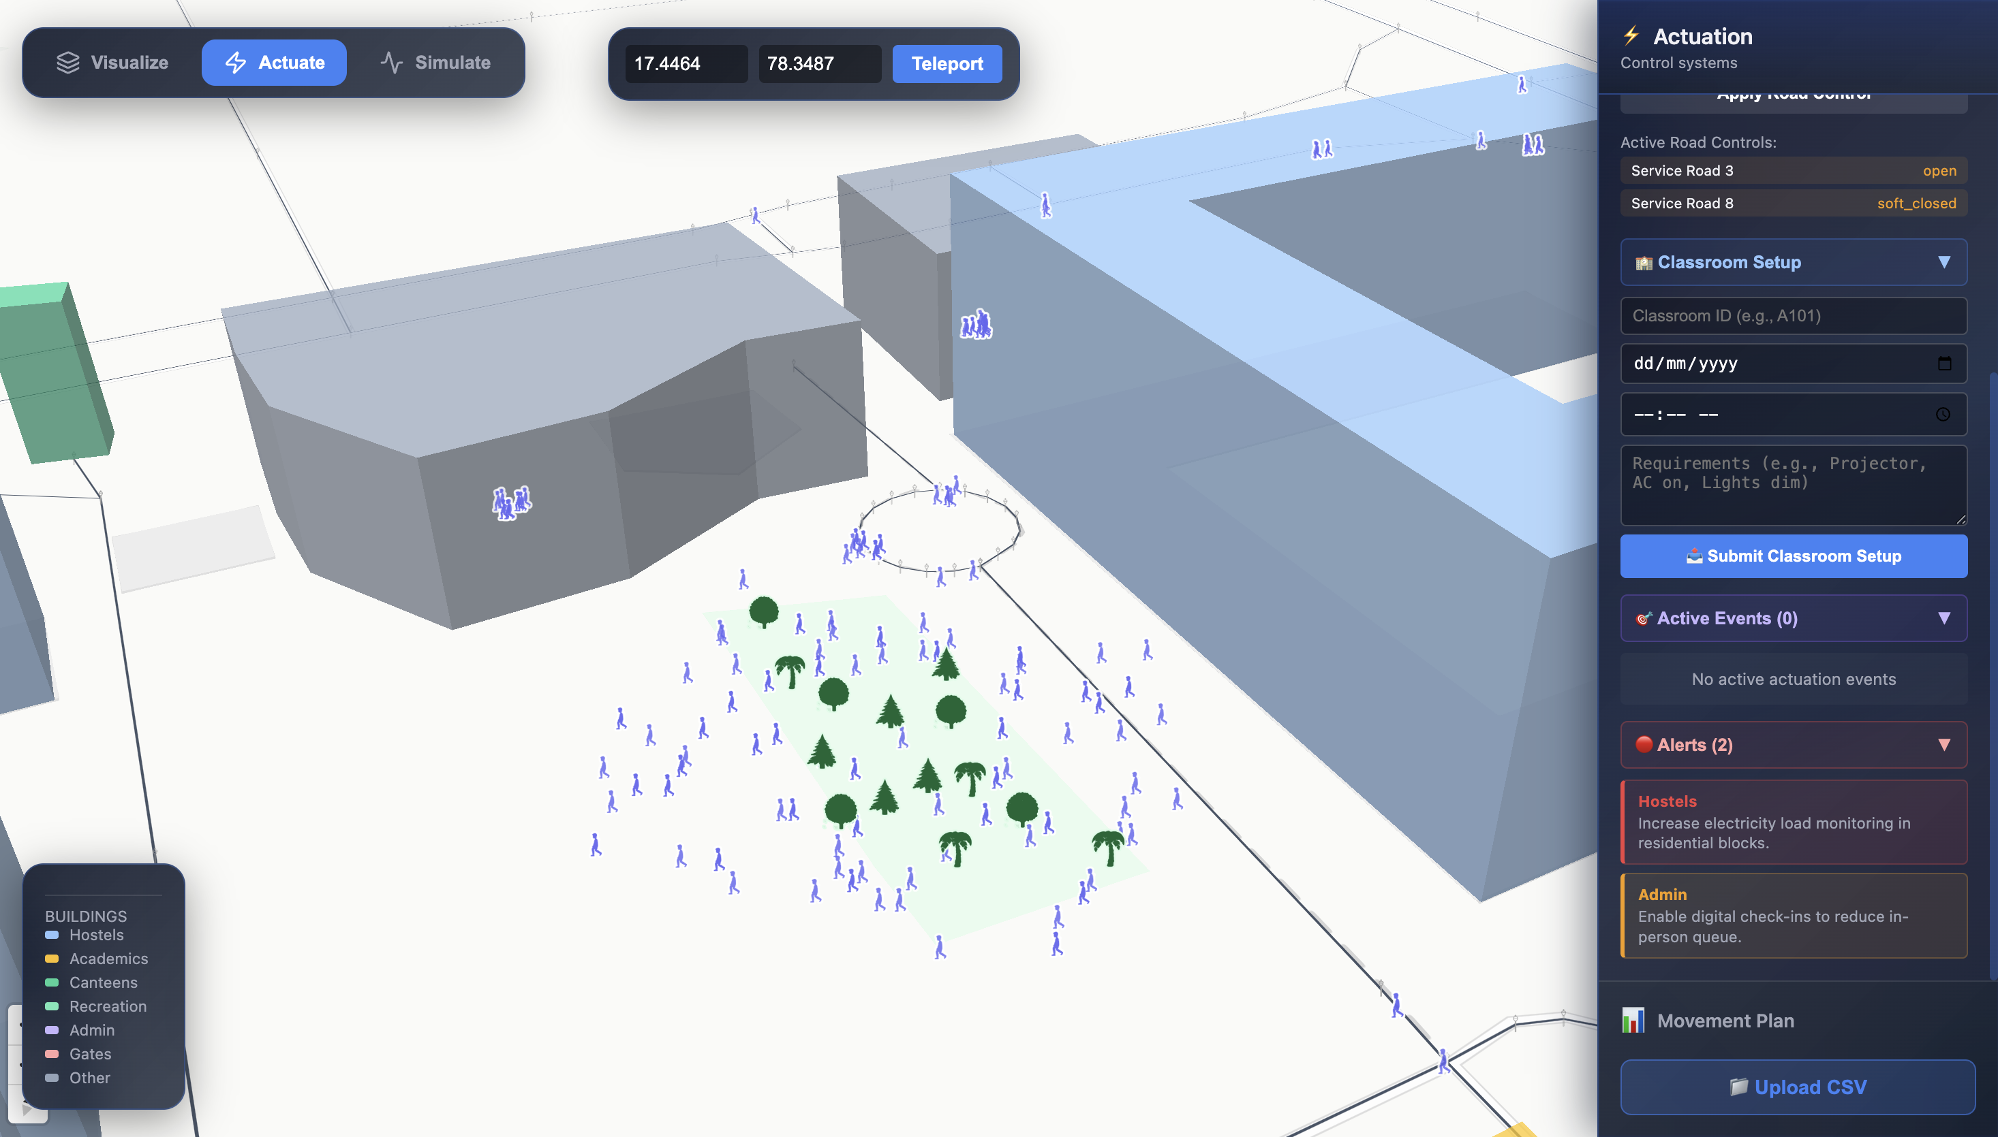
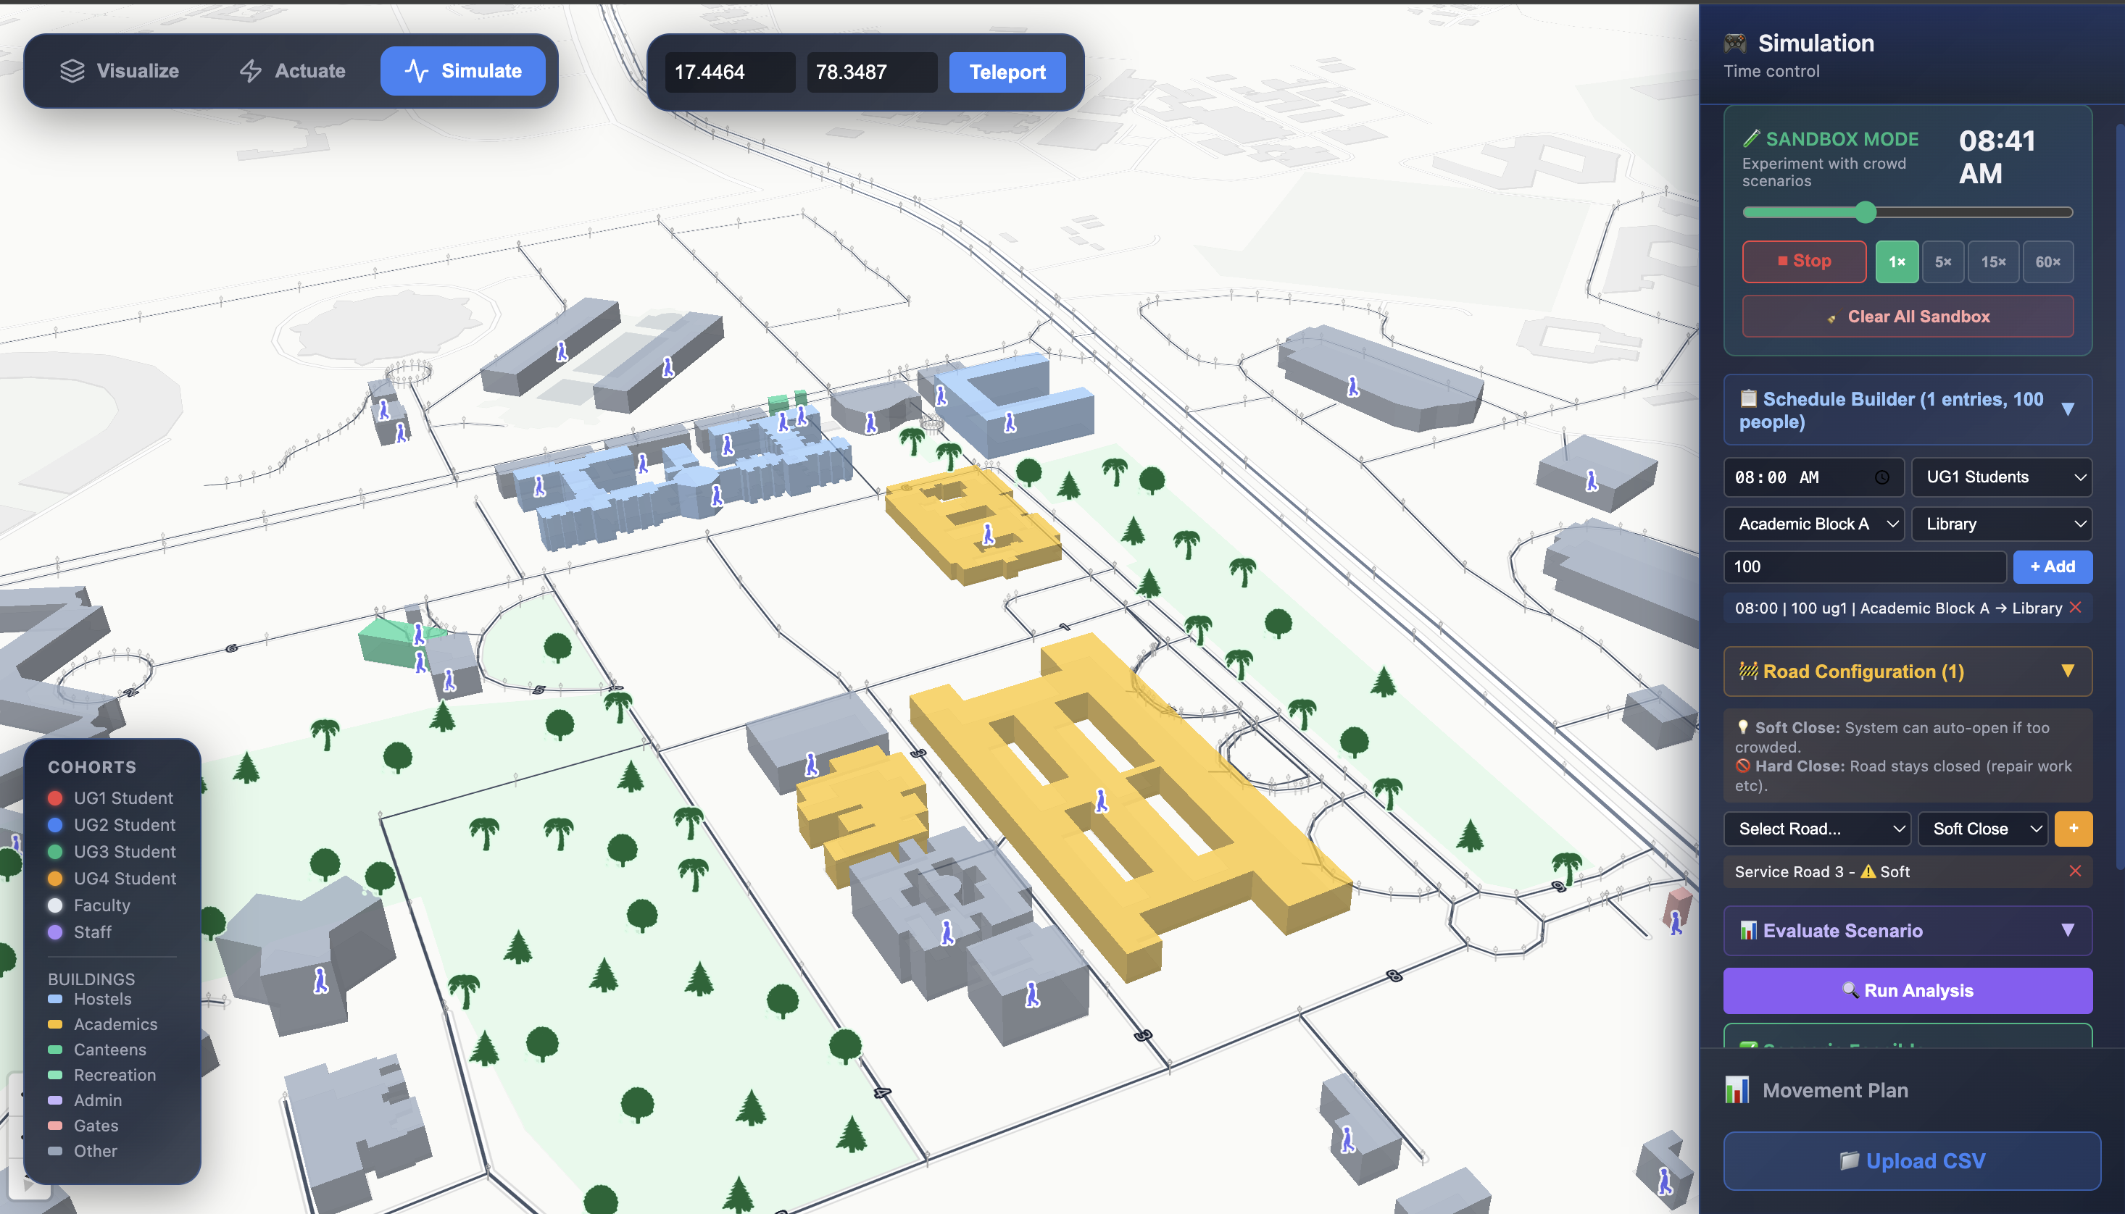
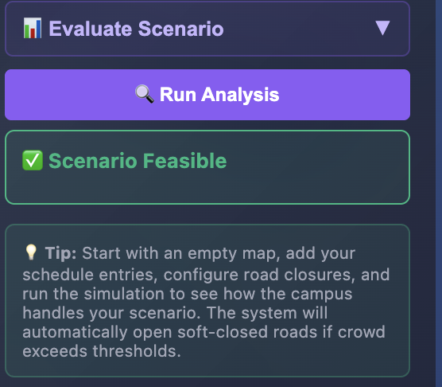
Wireframes/Mock diagrams of the proposed solution
See attached screenshots: Visualize Mode, Actuate Mode, Simulate Mode, 3D Map View
Visualisation Actuation(Control) Simulation

Slide 7
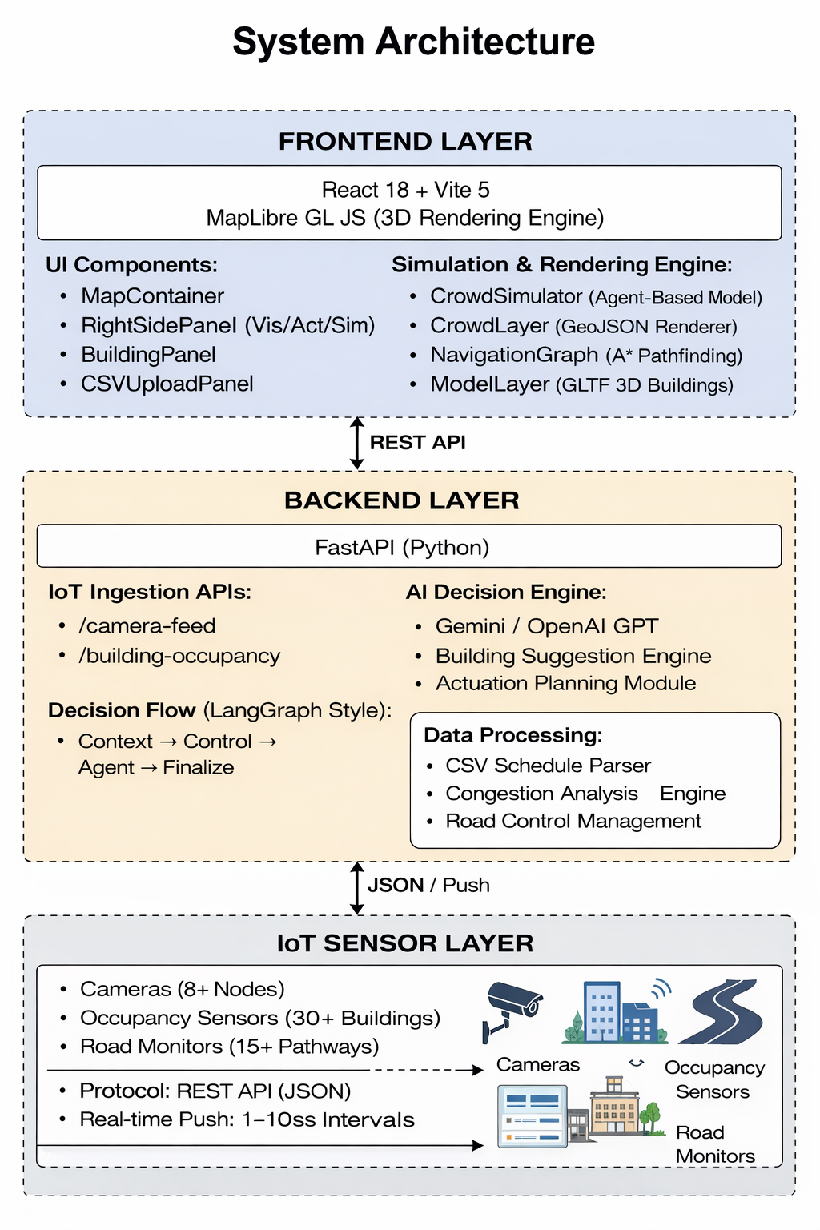
Architecture diagram of the proposed solution
System Architecture
FRONTEND LAYER: React 18 + Vite 5 + MapLibre GL JS (3D rendering)
• → Components: MapContainer, RightSidePanel (Vis/Act/Sim), BuildingPanel, CSVUploadPanel
• → Engine: CrowdSimulator (agents), CrowdLayer (GeoJSON), NavigationGraph (A* pathfinding), ModelLayer (GLTF)
BACKEND LAYER: FastAPI (Python) — REST API server
• → IoT Ingestion: /camera-feed, /building-occupancy (real-time sensor data)
• → AI Engine: Gemini / OpenAI GPT — building suggestions, actuation planning
• → Actuation: LangGraph-style decision graph (Context → Control → Agent → Finalize)
• → Data: CSV schedule parser, congestion analysis, road control management
IoT SENSOR LAYER: Cameras (8+ nodes), Occupancy Sensors (30+ buildings), Road Monitors (15+ pathways)
• → Protocol: REST API (JSON), Real-time push (1-10s intervals)

Slide 8
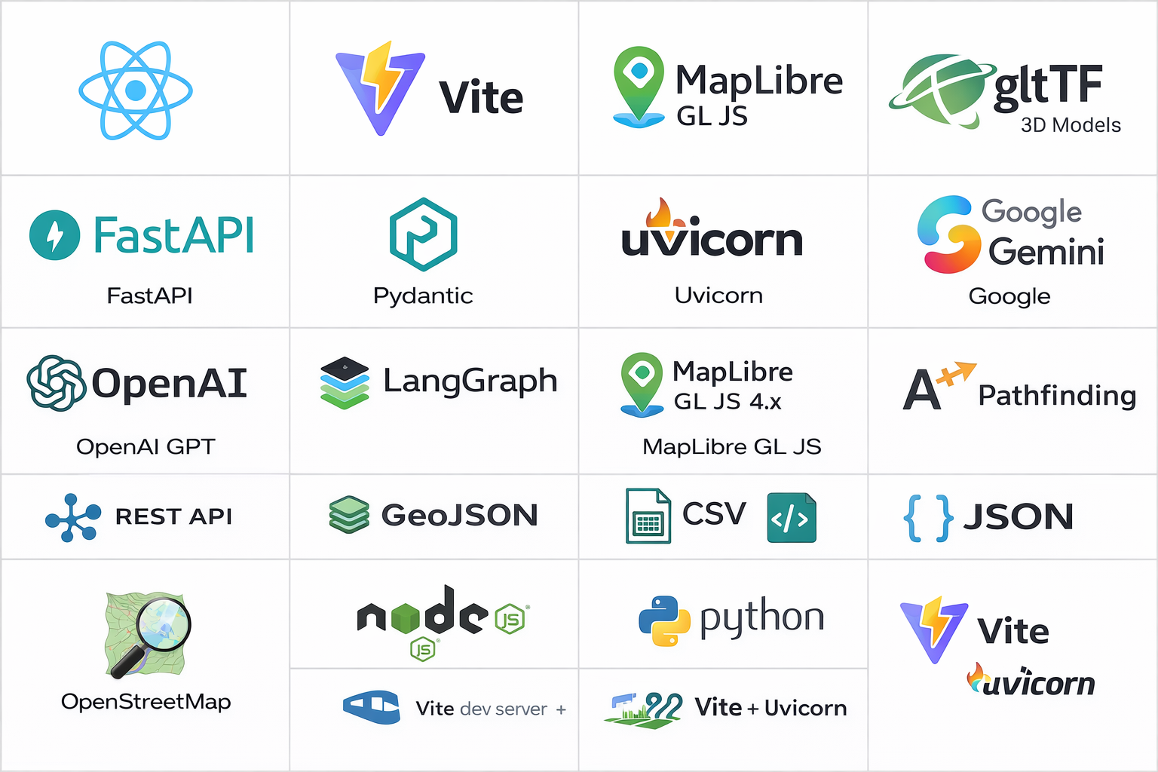
Technologies to be used in the solution
• FRONTEND: React 18, Vite 5, MapLibre GL JS 4.x, GLTF/GLB 3D Models
• BACKEND: FastAPI (Python 3.10+), Pydantic, Uvicorn
• AI/ML: Google Gemini API, OpenAI GPT API, LangGraph-style decision pipeline
• 3D ENGINE: MapLibre GL JS with custom WebGL layers, A* pathfinding, GeoJSON rendering
• IoT PROTOCOLS: REST API (JSON), Real-time sensor data ingestion
• DATA FORMATS: GeoJSON (spatial), CSV (schedules), JSON (API communication)
• MAPPING: OpenStreetMap data, OSM building footprints, campus pathways
• DEPLOYMENT: Node.js 18+, Python 3.10+, Vite dev server + Uvicorn

Slide 9
Usage of AMD Products/Solutions(Proposed)
• AMD GPU Acceleration: WebGL-powered 3D rendering of 1200+ agents in real-time on MapLibre GL
• AMD Ryzen Processors: Backend AI inference and congestion analysis runs efficiently on AMD hardware
• AMD Instinct (Future): Scale AI decision pipeline to handle campus-wide sensor data in real-time
• AMD ROCm (Future): Optimize crowd prediction models using AMD's open-source ML framework
• AMD Embedded (IoT): IoT edge processing on AMD Xilinx FPGAs for camera-based people counting
• Performance: Smooth 60fps 3D rendering with 1000+ animated agents on AMD Radeon GPUs

Slide 10
Estimated implementation cost (TBD)
• IoT Cameras, Occupancy Sensors,
• Edge Computing Hardware (AMD Xilinx FPGAs)
• Cloud Server (FastAPI + AI APIs)
• AI API Costs (Gemini/GPT
• Development & Maintenance: Open Source
Currently using free tier deployments, if support given services/compute from AMD can be used to deploy with in the Smart City Living Lab –IIITH Campus

Slide 11
Prototype Assets (V1)
GitHub Public Repository Link
https://github.com/likhithkanigolla/CrowdTwin
Demo Video Link (Max: 3 Minutes)
https://drive.google.com/drive/folders/14enyEwmFWi9_9jwwZTjx1caFQ9Bj-fJf?usp=sharing

Slide 12
Real Time Validation
IoT Sensor Deployment Plan(at Smart City Living Lab)
• Camera Nodes (8+): Deployed at all building entrances and main road intersections
• → Data: People count, direction (in/out), GPS coordinates, timestamps
• → Frequency: Real-time (1-5 second intervals)
• Building Occupancy Sensors (30+): Installed in all classified buildings
• → Data: Current occupancy, capacity, last update timestamp
• → Categories: Hostels, Academics, Canteens, Recreation, Admin, Gates
• Road Monitors (10+): Placed along campus pathways
• → Data: Traffic flow, congestion level, road status
• → Control: Open / Soft Close / Hard Close via REST API
• Environmental Sensors (Future): Temperature, humidity, air quality in high-density zones

Slide 13


